Slide 1
Data transfer from Bluetooth Module
This application will receive the data from the Bluetooth module which is attached to some sensor. It will store the data in the mobile for further analysis

Slide 2
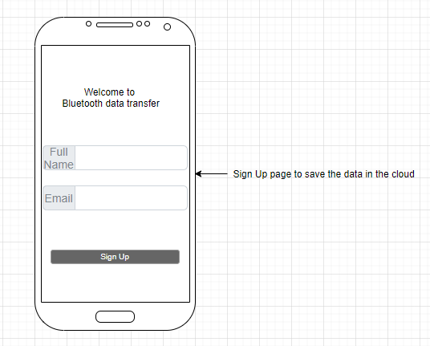

Slide 3
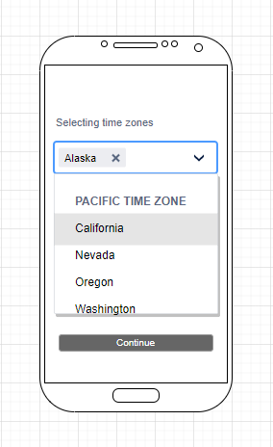

Slide 4
